Slide 1
CSCI1540 Fundamental Computing with C++
Basics of Control Flow
Fall, 2019

Slide 2
Introduction
Flow of controls – the order in which instructions are executed in a program
Flow of controls can be fully expressed using three kinds of controls
Sequential: Execute instructions one after another
Selective: Conditionally execute instructions
Repetitive: Repeatedly execute instructions

Slide 3
Outline
Relational and equality operators
Selective control structures
if statement
if-else statement
Logical operators
Repetitive control structure
while statement

Slide 4
1. Comparison Operators
Operator | Example | Meaning
== | x == y | Is x equal to y?
!= | x != 10 | Is x not equal to 10?
> | x > 3 | Is x greater than 3?
< | y < 0 | Is y less than 0?
>= | x >= y | Is x greater than or equal to y?
<= | y <= -4 | Is y less than or equal to -4?

Slide 5
1.1 Results of Comparison
The comparison result is either true or false
The data type of true/false is bool
Suppose x and y are declared as:
int x = 0, y = 100;
x > 10 → false
'A' != 'B' → true
y >= (x + 100) → true
100 == (x + y) → true

Slide 6
Operator Precedence and Associativity
Operator | Associativity | Precedence
() ++ (postfix) -- (postfix) | Left-to-right | Highest Lowest
+ (unary) - (unary) ++ (prefix) -- (prefix) ! | Right-to-left
* / % | Left-to-right
+ - | Left-to-right
< <= > >= | Left-to-right
== != | Left-to-right
&& | Left-to-right
|| | Left-to-right
?: | Right-to-left
= += -= *= /= %= etc. | Right-to-left
, (comma operator) | Left-to-right

Slide 7
1.2 Integer Values and Boolean Types
true, when treated as integer, is converted to 1
false, when treated as integer, is converted to 0
Any non-zero value is treated as true
Zero is treated as false
cout prints true as 1 and false as 0 by default
E.g.:
cout << false; // Prints 0
bool foo = -2; // foo is true
cout << foo; // Prints 1

Slide 8
2. if Statement: Syntax
if (expr)
statement;
next_statement;
expr
true
false
statement
next_statement
Allows us to conditionally perform a task
“statement” is executed only if expr is evaluated to true

Slide 9
2. if Statement: Example
1
2
3
4
5
6
7
8
9
int score;
cout << "Please enter your score: ";
cin >> score;
if (score >= 50)
cout << "Passed!\n";
if (score < 50)
cout << "Failed!\n";
cout << "Your score is " << score << endl;
Please enter your score: 80↵
Passed!
Your score is 80
Please enter your score: 40↵
Failed!
Your score is 40

Slide 10
What's the output if x is …?
1
2
3
4
if (x % 10 == 0)
cout << "A";
cout << "B";
cout << "C";
Same as
1
2
3
4
if (x % 10 == 0)
cout << "A";
cout << "B";
cout << "C";
Indentation: adding spaces at the beginning of a line to align codes.
Indenting codes does not affect a program; it only makes the codes easier to read
How do we conditionally execute multiple statements then?

Slide 11
2.1 Compound Statement
1
2
3
4
5
6
7
8
9
10
char grade = '-';
if (score >= 50) {
grade = 'P';
cout << "Congratulations!\n";
}
if (score < 50)
grade = 'F';
cout << "Your score is " << score << endl;
cout << "Your grade is " << grade << endl;
Execute all the statements between { and } if score ≥ 50
{ … } groups multiple statements into ONE compound statement
Semicolon (;) is not needed after { … }

Slide 12
2.2 if-else Statement: Syntax
if (expr)
statement_1;
else
statement_2;
next_statement;
false
expr
true
statement_2
statement_1
next_statement
Allows us to conditionally perform one of two tasks

Slide 13
2.2 if-else Statement: Example
1
2
3
4
5
6
7
8
9
int score;
cout << "Please enter your score: ";
cin >> score;
if (score >= 50)
cout << "Passed!\n";
else // Replaces "if (score < 50)"
cout << "Failed!\n";
cout << "Your score is " << score << endl;
If “score >= 50” is true, then “score < 50” will be false, and vice versa

Slide 14
2.3. How does else pair with if?
if (x % 2 == 1)
if (x > 100)
cout << "A";
else
cout << "B";
if (x % 2 == 1)
if (x > 100)
cout << "A";
else
cout << "B";
if (x % 2 == 1) {
if (x > 100)
cout << "A";
else
cout << "B";
}
if (x % 2 == 1) {
if (x > 100)
cout << "A";
} else
cout << "B";
if (x % 2 == 1)
if (x > 100)
cout << "A";
else
cout << "B";
else
cout << "C";
In the absence of {}, an else is always paired with the nearest preceding if that does not already have an else paired with it
In the absence of {}, an else is always paired with the nearest preceding if that does not already have an else paired with it
In the absence of {}, an else is always paired with the nearest preceding if that does not already have an else paired with it
In the absence of {}, an else is always paired with the nearest preceding if that does not already have an else paired with it

Slide 15
Dangling-else: Exercise
Consider this badly-formatted code:
Format the code with proper spacing and indentation
What is the output assuming:
x is 5 and y is 8?
x is 5 and y is 7?
x is 4 and y is 8?
x is 4 and y is 7?
if(y==8)if(x==5)cout<<"@\n";else
cout<<"#\n";cout<<"$\n";cout<<"&\n";

Slide 16
2.4 Conditionally Performing 1 of N Tasks
An if-else statement only branches two ways. How do we branch multiple ways?
Example: Ask the user for three choices and perform one of three tasks accordingly?
Solution: Use multiple if-else statements

Slide 17
2.4 Conditionally Performing 1 of N Tasks: Example
int choice;
…
cout << "Please enter your choice (1-3): ";
cin >> choice;
// Carry out the corresponding task
if (choice == 1)
…… // Carry out task #1
if (choice == 2)
…… // Carry out task #2
if (choice == 3)
…… // Carry out task #3
Observation: In this example, the three conditions are exclusive
If choice is 1, there is no need to check if choice is 2 or 3

Slide 18
2.4 Conditionally Performing 1 of N Tasks: Improved Version #1
int choice;
…
cout << "Please enter your choice (1-3): ";
cin >> choice;
// Carry out the corresponding task
if (choice == 1)
…… // Carry out task #1
else
if (choice == 2)
…… // Carry out task #2
else
if (choice == 3)
…… // Carry out task #3
Nested if-else statements:
if-else statements within if-else statements

Slide 19
2.4 Conditionally Performing 1 of N Tasks: Improved Version #2
int choice;
…
cout << "Please enter your choice (1-3): ";
cin >> choice;
// Carry out the corresponding task
if (choice == 1)
…… // Carry out task #1
else
if (choice == 2)
…… // Carry out task #2
else
if (choice == 3)
…… // Carry out task #3
Different style of indentation (Easier to see how the if’s are paring with the else’s)

Slide 20
Multiway Branch
if (cond1)
stmt1;
else
if (cond2)
stmt2;
else
stmt3;
next_stmt;
true
cond1
false
true
cond2
false
stmt1
stmt2
stmt3
next_stmt

Slide 21
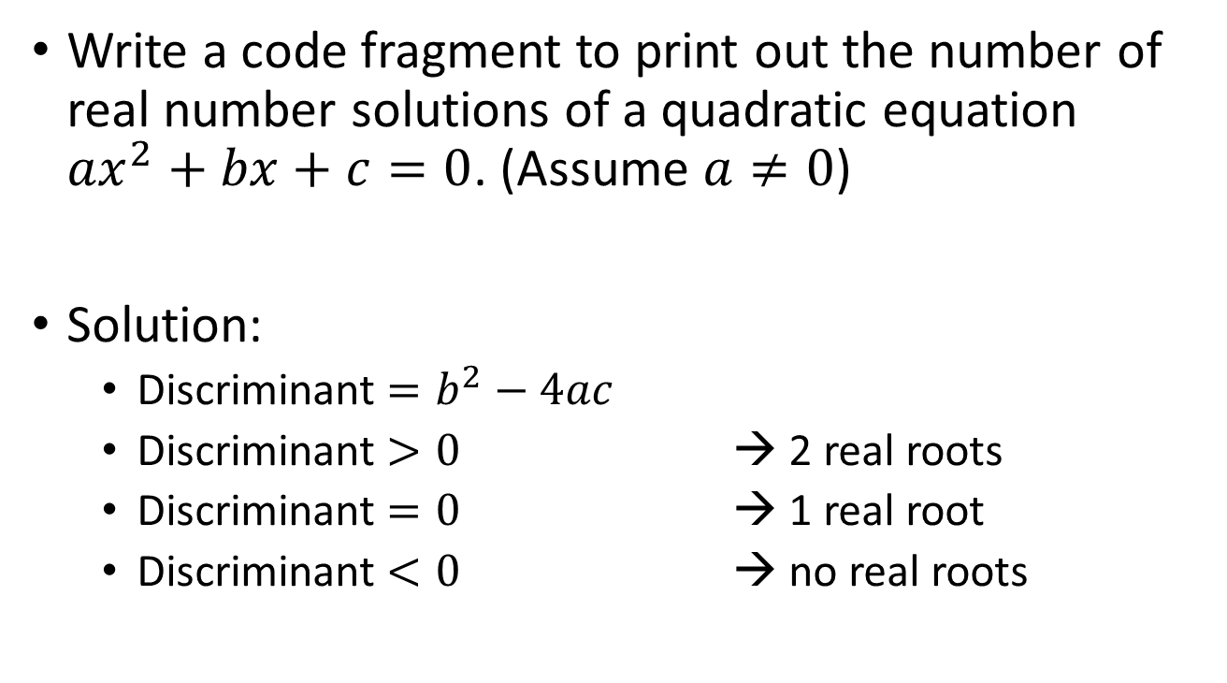
Using if-else: Example
Write a code fragment to print out the number of real number solutions of a quadratic equation $ax^{2}+bx+c=0$. (Assume $a≠0$)
Solution:
Discriminant $=b^{2}−4ac$
Discriminant $>0$ → 2 real roots
Discriminant $=0$ → 1 real root
Discriminant $<0$ → no real roots

Slide 22
Using if-else: Example (Version #1)
1
2
3
4
5
6
7
8
9
10
11
double a, b, c; // To store the coefficients
cin >> a >> b >> c;
if (b * b – 4 * a * c > 0)
cout << "# of real number solutions: 2\n";
if (b * b – 4 * a * c == 0)
cout << "# of real number solutions: 1\n";
if (b * b – 4 * a * c < 0)
cout << "# of real number solutions: 0\n";

Slide 23
Using if-else: Example (Version #2)
1
2
3
4
5
6
7
8
9
10
11
12
13
14
15
double a, b, c; // To store the coefficients
double delta; // The discriminant
int sol; // # of real number solutions
cin >> a >> b >> c;
delta = b * b – 4 * a * c; // Compute discriminant once
if (delta > 0)
sol = 2;
else if (delta == 0)
sol = 1;
else // Otherwise delta < 0
sol = 0;
cout << "# of real number solutions: " << sol << "\n";
In this version, the amount of computation is reduced

Slide 24
3. Forming Compound Boolean Expressions
How can we express “score is between 90 and 100”?
Wrong to express the condition as:
(90 <= score <= 100) 👎
We need to express the condition as
(score >= 90 && score <= 100) 👍
which means “score ≥ 90 AND score ≤ 100”
In C++, && represents the “logical AND” operator.

Slide 25
3.1 Logical Operators in C++
Logical operators allow us to create compound condition – a condition made up of multiple sub-conditions
Logical AND (&&):
Logical OR (||):
Logical NOT (!):
if ( grade >= 0 && grade < 50 )
cout << "F";
if ( grade < 0 || grade > 100 )
cout << “Error. Grade out of range";
if ( ! (grade < 50) )
cout << “D or better grade";

Slide 26
3.2 Logical AND &&
If your total score is at least 50 AND final exam score is at least 40, you will pass the course
If one of the conditions is false, the whole condition becomes false
Condition 1 | Condition 2 | AND Result
true | true | true
true | false | false
false | true | false
false | false | false

Slide 27
3.3 Logical OR ||
If you spend over $400 OR have a coupon, you will receive free shipping
If one of the conditions is true, the whole condition becomes true
Condition 1 | Condition 2 | OR Result
true | true | true
true | false | true
false | true | true
false | false | false

Slide 28
3.4 Logical NOT (Negation) !
If you are NOT a local student, you have to pay full tuition fee
Unary operator
Condition | NOT Result
true | false
false | true

Slide 29
Be Careful!
If the operands to the logical operators &&, ||, ! have value zero, they will be treated as false
Any non-zero operand values to these operators will be treated as true
int x = 0;
cout << !9 << " ";
cout << !!9 << " "; // !(!9) -> !0 -> 1
cout << !0 << " ";
cout << (x && 3) << endl;
0 1 1 0

Slide 30
Logical Operators: Exercises
Suppose x is 0, y is 10, evaluate the following:
x < 5 || !(y < 1)
x + y > -1 && y % 2 == 0
!!-y
Express the following conditions:
x is a number between -5 and 5 (inclusively)
x is greater than both y and z
x is negative but x + y is positive

Slide 31
Example
Write a code fragment to read three integers from the user and print them out in ascending order
Say, the values are stored in variables x, y, and z
Possible solution #1:
For each of the six possible arrangements, output the result accordingly: (1) x ≤ y ≤ z, (2) x ≤ z ≤ y, (3) y ≤ x ≤ z , (4) y ≤ z ≤ x, (5) z ≤ x ≤ y, and (6) z ≤ y ≤ x
Possible solution #2:
Sort the values of x, y, and z so that x ≤ y ≤ z

Slide 32
Example (Possible Solution #1)
1
2
3
4
5
6
7
8
9
10
11
12
13
14
15
int x, y, z; // To store input values
cin >> x >> y >> z;
if (x <= y && y <= z)
cout << x << " " << y << " " << z << "\n";
else if (x <= z && z <= y)
cout << x << " " << z << " " << y << "\n";
else if (y <= x && x <= z)
cout << y << " " << x << " " << z << "\n";
else if (y <= z && z <= x)
cout << y << " " << z << " " << x << "\n";
else if (z <= x && x <= y)
cout << z << " " << x << " " << y << "\n";
else
cout << z << " " << y << " " << x << "\n";

Slide 33
Broken Example (Possible Solution #1)
1
2
3
4
5
6
7
8
9
10
11
12
13
14
15
int x, y, z; // To store input values
cin >> x >> y >> z;
if (x <= y && y <= z)
cout << x << " " << y << " " << z << "\n";
if (x <= z && z <= y)
cout << x << " " << z << " " << y << "\n";
if (y <= x && x <= z)
cout << y << " " << x << " " << z << "\n";
if (y <= z && z <= x)
cout << y << " " << z << " " << x << "\n";
if (z <= x && x <= y)
cout << z << " " << x << " " << y << "\n";
if (z <= y && y <= x)
cout << z << " " << y << " " << x << "\n";
What's wrong with this version?

Slide 34
Example (Possible Solution #2)
1
2
3
4
5
6
7
8
9
10
11
12
13
14
15
16
17
int x, y, z, tmp;
cin >> x >> y >> z;
// First, make sure x holds the smallest value
if (x > y) {
tmp = x; x = y; y = tmp; // Swap x and y
}
if (x > z) {
tmp = x; x = z; z = tmp; // Swap x and z
}
// Next, make sure y <= z
if (y > z) {
tmp = y; y = z; z = tmp; // Swap y and z
}
cout << x << " " << y << " " << z << "\n";

Slide 35
4. while Statement: Syntax
while (expr)
statement;
next_statement;
expr
statement
false
true
next_statement
Allows us to conditionally perform a task repeatedly

Slide 36
Using while Loop
Decide what statements to be executed repeatedly
Specify a looping condition
We can typically introduce a variable to control the loop
If the condition is true, execute loop body
If the condition is false, leave the loop
Example: Write a code fragment to repeatedly output the square of the input value until the input value becomes zero

Slide 37
4.1 Controlling a Loop
1
2
3
4
5
6
7
8
9
10
11
int input;
input = 1;
while (input != 0) {
cout << "Enter a number (0 to stop): ";
cin >> input;
if (input != 0)
cout << "Square of " << input << " is "
<< input * input << endl;
}
Example of using while loop to keep printing the square of an input value until the input value becomes zero

Slide 38
1
2
3
4
5
6
7
8
9
10
11
int input;
input = 1;
while (input != 0) {
cout << "Enter a number (0 to stop): ";
cin >> input;
if (input != 0)
cout << "Square of " << input << " is "
<< input * input << endl;
}
Specify a condition to stop the loop
Introduce a loop variable to control when the loop stops
The loop stops when the loop variable obtains some “special” value

Slide 39
1
2
3
4
5
6
7
8
9
10
11
int input;
input = 1;
while (input != 0) {
cout << "Enter a number (0 to stop): ";
cin >> input;
if (input != 0)
cout << "Square of " << input << " is "
<< input * input << endl;
}
Remember to initialize the loop variable if you want to make sure the loop iterates at least once

Slide 40
1
2
3
4
5
6
7
8
9
10
11
int input;
input = 1;
while (input != 0) {
cout << "Enter a number (0 to stop): ";
cin >> input;
if (input != 0)
cout << "Square of " << input << " is "
<< input * input << endl;
}
Make sure you have some code in the loop body to modify the loop variable
Otherwise the loop won't stop!

Slide 41
Controlling a Loop with a Loop Variable: a General Approach
bool loopVar; // (1) Introduce a loop variable
loopVar = true; // (2) Initialize the loop variable
while (loopVar == true) {
// Statements that need to be iterated go here
…
/* (3) Decide when the loop should stop.
Whenever a loop should stop, set the loop
variable to false */
if ( /* Loop should stop */ )
loopVar = false;
}

Slide 42
Controlling a Loop: Example (Ver. 1)
Repeatedly read three integers from the user until exactly two of the input are positive
1
2
3
4
5
6
7
8
9
10
11
12
13
14
15
16
int num1, num2, num3;
bool loopVar = true;
while (loopVar == true) {
cout << "Enter three integers: ";
cin >> num1 >> num2 >> num3;
if (num1 > 0 && num2 > 0 && num3 <= 0)
loopVar = false;
if (num1 <= 0 && num2 > 0 && num3 > 0)
loopVar = false;
if (num1 > 0 && num2 <= 0 && num3 > 0)
loopVar = false;
}

Slide 43
Controlling a Loop: Example (Ver. 2)
Repeatedly read three integers from the user until exactly two of the input are positive
1
2
3
4
5
6
7
8
9
10
11
int num1, num2, num3;
num1 = num2 = num3 = 0;
/* Continue to loop when NOT exactly two of the inputs
are positive */
while ( !((num1 > 0 && num2 > 0 && num3 <= 0) ||
(num1 <= 0 && num2 > 0 && num3 > 0) ||
(num1 > 0 && num2 <= 0 && num3 > 0)) ) {
cout << "Enter three integers: ";
cin >> num1 >> num2 >> num3;
}

Slide 44
4.2 Counter-Controlled Loop
1
2
3
4
5
6
7
int i;
i = 1;
while (i <= 5) {
cout << i << endl;
i++;
}
1
2
3
4
5
Number of repetitions is known
Loop variable serves as counter
Need to initialize loop variable
Need to set the “final value” of the loop variable in the condition
Need to increase the value of the loop variable in the loop (usually as the last statement in the loop body)

Slide 45
4.2 Counter-Controlled Loop
A.
int i = 1;
while (i <= 5) {
cout << "Hello!\n";
i++;
}
B.
int i = 0;
while (i < 5) {
cout << "Hello!\n";
i++;
}
C.
int i = 5;
while (i > 0) {
cout << "Hello!\n";
i--;
}
D.
int i = 1;
while (i <= 10) {
cout << "Hello!\n";
i += 2;
}
Which of these code fragments print(s) exactly five “Hello!”?
There are many different ways to count…

Slide 46
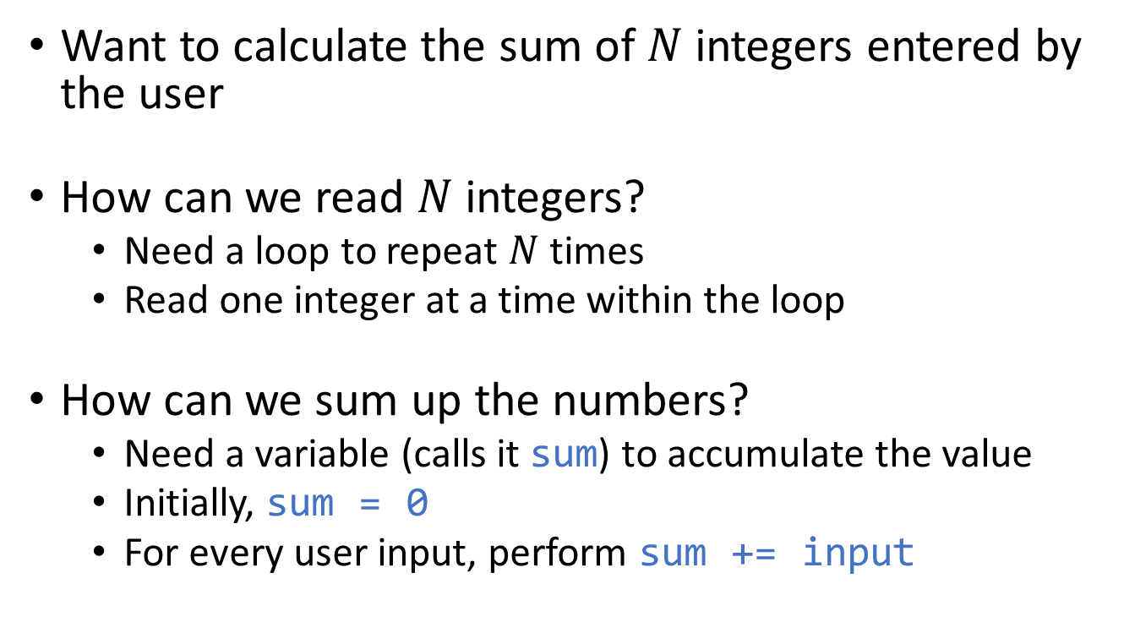
Counter-Controlled Loop: Example 1
Want to calculate the sum of $N$ integers entered by the user
How can we read $N$ integers?
Need a loop to repeat $N$ times
Read one integer at a time within the loop
How can we sum up the numbers?
Need a variable (calls it sum) to accumulate the value
Initially, sum = 0
For every user input, perform sum += input

Slide 47

1
2
3
4
5
6
7
8
9
10
11
12
13
14
15
16
17
18
19
20
#include <iostream>
using namespace std;
int main() {
int cnt, sum, n, input;
cout << "How many numbers do you wish to enter? ";
cin >> n;
cout << "\nEnter " << n << " integers:\n";
sum = 0; // Initially, sum is 0
cnt = 1; // Count from 1 to n
while (cnt <= n) {
cin >> input;
sum += input;
cnt++;
}
cout << "The sum is " << sum << endl;
return 0;
}
Example 1: Find the sum of $N$ integers

Slide 48
Example 1: Program Output
How many numbers do you wish to enter? 4↵
Enter 4 integers:
4 3 99 20↵
The sum is 126
Sample output of the previous program

Slide 49
Counter-Controlled Loop: Example 2
Want to find the largest number among N integers entered by the user
How can remember the largest value?
Use a variable (call it max) to keep the largest value
For each input value, check:
What should be the initial value of max?
if (max < input)
max = input;

Slide 50

1
2
3
4
5
6
7
8
9
10
11
12
13
14
15
16
17
18
int cnt, n, max, input;
cout << "How many numbers do you wish to enter? ";
cin >> n; // Assume n > 0
cout << "\nEnter " << n << " integers:\n";
cin >> max; /* Read the 1st integer, and
mark it as the largest number so far */
// Now we need only to check the remaining n - 1 integers
cnt = 1;
while (cnt <= n - 1) {
cin >> input;
if (max < input) // Record the value of the
max = input; // largest number if necessary
cnt++;
}
cout << "\nMaximum value: " << max << endl;
Example 2: Find the largest among $N$ integers

Slide 51
Example 2: Program Output
How many numbers do you wish to enter? 4↵
Enter 4 integers:
4 3 99 20↵
Maximum value: 99
Sample output of the previous program

Slide 52
Exercise
Read 10 integers from the user
Display:
the number of inputs that are ≥ 50, and
the number of inputs that are < 50
Print out “Great!” if there are more than 7 inputs that are ≥ 50; print out “Poor!” otherwise
Example run:
Enter 10 integers:
8 44 78 27 66 3 99 -2 20 50↵
4 inputs >= 50
6 inputs < 50
Poor!

Slide 53
4.3 Infinite Loop
Infinite loop: a loop that never stops
E.g.:
Usually introduced by mistake
Some common mistakes resulting in infinite loops:
A condition that is always true:
Failing to update a loop variable
while (true)
cout << "Hello!\n";
while (a * a >= 0) {
…
}
while (a >= 5 || a < 9) {
…
}
int i = 0;
while (i < 5) {
cout << "i = " << i << endl;
}
i is always… 😢

Slide 54
Common Mistakes Resulting in Infinite Loops
Using = instead of == as equality operator
Placing a ; after the condition of a while loop
while (a = 1) {
…
}
a is assigned 1. (No equality checking)
The whole expression evaluates to 1
1 means true
while (a != 0);
{
…
}
; represents an empty statement.
That is, writing
while (a != 0);
is the same as writing
while (a != 0) { }

Slide 55
Summary
Know how to evaluate and express conditions involving relational, equality and logical operators
Know how to use (nested) if-else statement to conditionally execute codes in the program
Know how to use while statement to repeatedly perform a task, regardless whether the number of repetitions is known or not
Next: Advanced control flow…

